Slide 1
Change Notifications with Microsoft Graph
Notes:
Microsoft Graph enables developers to consume user information stored in Microsoft 365 in custom applications. Data is retrieved from Microsoft Graph through a REST API or using one of the various native SDKs provided by Microsoft.
In this module, you'll learn how to work with change notifications (webhooks) & track changes (delta query) in the Microsoft Graph.
In this unit, you'll learn how Microsoft Graph fits into the larger Microsoft 365 platform. Next, you'll learn how to create a .NET Core web API that will be used to create and receive HTTP POST requests from Microsoft Graph.

Slide 2
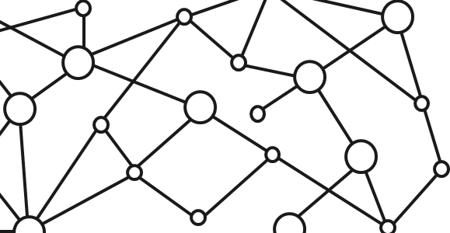
Microsoft 365 Platform
Extend Microsoft 365 experiences
web, device, and service apps
Build your experience
Documents
Pages
Conversations
Timeline
iOS/Android/Windows/Web
1
Microsoft Graph
Notes:
The Microsoft 365 developer vision focuses on the user's experience and their data and as a developer you can bring your application into the user experience with over 1.2 billion users of office worldwide. This is a huge opportunity to provide a window into your application and to enable users to connect into their data to intelligence to your application.
There are currently over 850 million events created each month and a total of over 400 petabytes of data stored in the service that can add value for your users.
The Microsoft Graph is the gateway to your data in the Microsoft cloud.
The Microsoft cloud is included of multiple services and data types that we can take advantage of from Office 365, and it's all considered part of the Microsoft 365 platform.
Developers can integrate the signed-in user's email, calendar, contacts, and tasks into custom apps. We can work with content in SharePoint sites and lists files in OneDrive, channels and content within Microsoft Teams, and users in Azure Active Directory (Azure AD).
There are many different services that developers can take advantage of in their custom apps. Many of these services have their own APIs developers can interact with.
One of the benefits of Microsoft Graph is that it serves as a proxy endpoint to all of these other services. Microsoft Graph encompass things such as Office 365, Windows 10 enterprise mobility and security (EMS), and it brings all of these different services under one unified endpoint: **graph.microsoft.com**.
The advantage to using Microsoft Graph is that it allows developers to just have a single endpoint, a resource, which means you're only going to need a single access token authenticate the different services. Each service still has its own individual permissions so that everything is still secured in an individual way. A single endpoint makes it easier for developers to build applications.
Microsoft Graph also enables easy navigation of entities and the relationships between entities. While there are many different Microsoft 365 services such as OneDrive for files, or Outlook for contacts and calendars, these different entities are related to each other. These relationships are in Microsoft Graph, which makes it easy to navigate from one entity to another, even if it crosses different underlying endpoints.

Slide 3
Change notifications with the Microsoft Graph API
Allows applications to be notified when data changes in the Microsoft Graph
Subscribe to particular notifications
Renew subscriptions for notifications as needed
Combine notifications with track changes for robust data notifications
Use ngrok to simplify local development with notifications
Notes:
Let's focus on a specific feature Microsoft Graph has to offer developers: change notifications.
Change notifications enable applications to be alerted when data changes or is created in Microsoft Graph. When the wanted entity is created, updated, or deleted, Microsoft Graph submits an HTTP POST to the specified endpoint. Your custom endpoint listens for these messages and acts on them based on the logic defined by your business requirements.

Slide 4
Change notifications with the Microsoft Graph API
Get notifications for messages, events, contacts, users, groups, conversations, OneDrive files & alerts endpoints
Stay up to date and in-sync with data in the Microsoft Graph
No “polling” at regular intervals required
Never miss a change
Notes:
What can you get notifications for?
You can get notifications on messages, events, contacts, users, groups, conversations, OneDrive files, and alerts. This allows you to stay up to date and in sync with data that that is accessible via Microsoft Graph. It also allows you to avoid implementing a polling infrastructure where you submit requests to Microsoft Graph at regular intervals to get the most recent changes. Instead, you can go back to Microsoft Graph asking for changes when a notification is received by your application. This way you'll never miss a change to data that is exposed or was accessible via Microsoft Graph.

Slide 5
Example notification scenarios
Translate an email when it arrives
Start a Flow when a document is X many months old
Create new user accounts in your application when a users joins an organization
Notes:
Let's look at a couple of different example notifications scenarios.
Change notifications allow you to, for example, when an email is received, you can translate it from its native language to another language and make it easier for the consumer to read that email.
In another scenario, consider you need to create a new user account in your application when a new user joins an organization.
All employees in the organization need an account in the corporate third-party time tracking system or third-party CRM system. When a new user is added to our organization, you can automatically create that user in the external service and send them an email alerting them that their new account has been set up.
How would you implement this with change notifications?
You first need to create an app that will host we web API to listen for notifications. This will be the component that won't just trigger the request to create the subscription, manage subscription renewals and receive and respond to notifications received from Microsoft Graph.

Slide 6
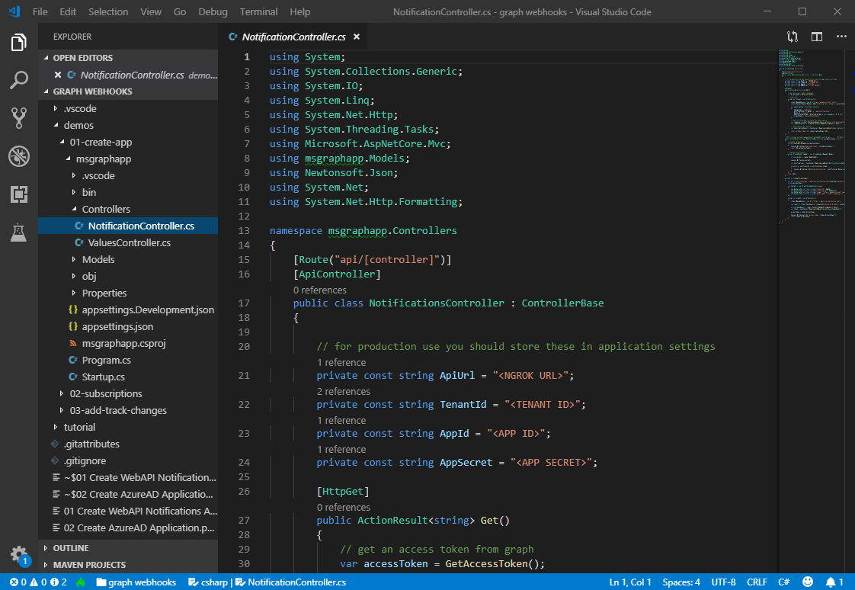
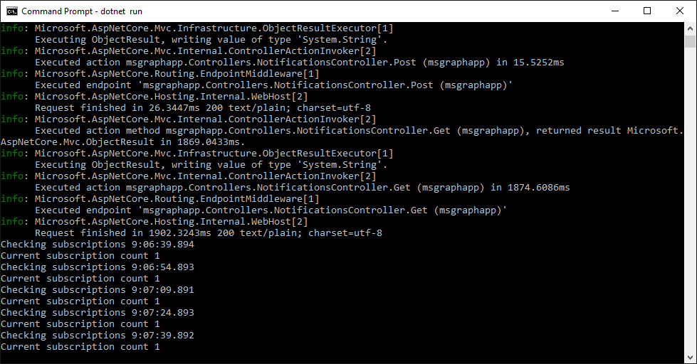
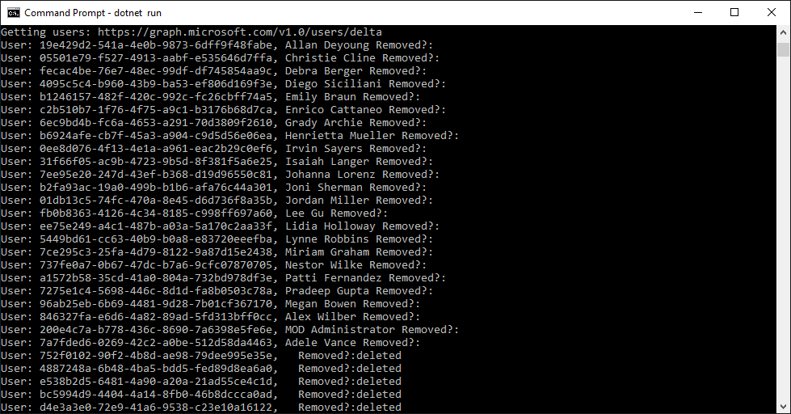
Get notified when user data changes
Create the app
Build a .NET Core WebApi application
Subscribe for notifications
Add code to subscribe to notifications when user data changes
Receive notifications
Add code to handle notifications when they occur
Notes:
Your application is notified of this activity by creating a subscription with Microsoft Graph. The subscription tells Microsoft Graph what entities you want to receive notifications about and the address of your web API to post them to.
Developers must renew subscriptions for notifications as needed as all subscriptions have an expiration time associated with them. If the subscription isn't renewed, it will eventually expire. You'll have to keep track of the subscriptions and make sure that you renew.
The development experience for creating an app that receives change notifications can be challenging because you do have to stand up a well-known and accessible HTTPS secured endpoint to receive the notifications.
A free tool, [ngrok](https://ngrok.com) simplifies the developer experience. It creates a temporary well-known endpoint that redirects to your developer environment. Once you start your local web server to host your application, you start ngrok in a separate process. Ngrok creates a public HTTPS secured endpoint that points to our local web server. Once both are running, Microsoft Graph will be able to submit HTTP POST requests to the Ngrok URL, which will be routed down to our local web server.

Slide 7
Demo

Slide 8
Thank you.

